Slide 1
Joining Datasets Part 2

Slide 2
left_join() Function
Command Illustration
new_dataframe_name <- dataframe_left %>%
left_join(dataframe_right, c("colname_1" = "colname_2"))

Slide 3
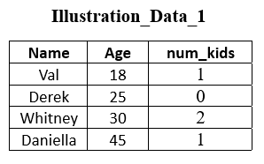
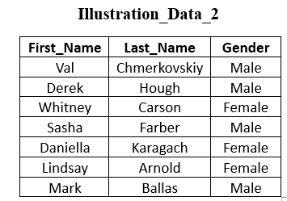

Slide 4
Example 1: Do a left join where Illustration_Data_1 is the left data and Illustration_Data_2 is the right data.
example_1 <- Illustration_Data_1 %>%
left_join(Illustration_Data_2, by = c("Name" = "First_Name"))

Slide 5
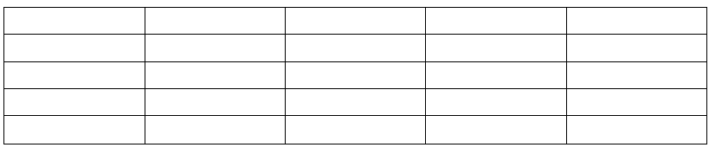
Output will be a dataframe that looks like:

Slide 6
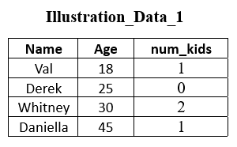

Slide 7
Example 2: Do a left join where Illustration_Data_2 is the left data and Illustration_Data_1 is the right data.
example_2 <- Illustration_Data_2 %>%
left_join(Illustration_Data_1, by = c("First_Name" = "Name"))

Slide 8
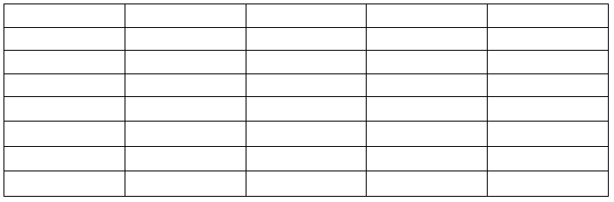
Output will be a dataframe that looks like:

Slide 9
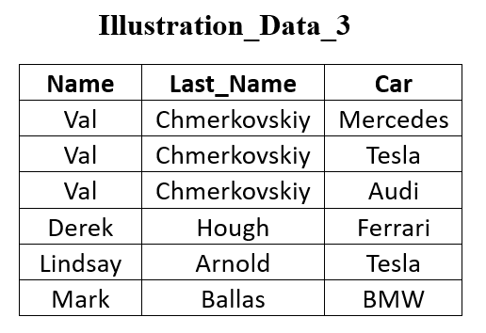
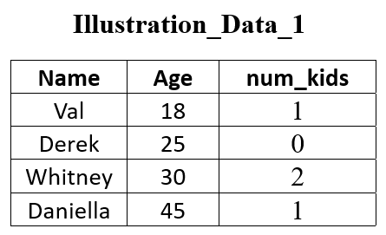

Slide 10
Example 3: Do a left join where Illustration_Data_3 is the left data and Illustration_Data_1 is the right data.
example_3 <- Illustration_Data_3 %>%
left_join(Illustration_Data_1, by = c("Name" = "Name"))

Slide 11
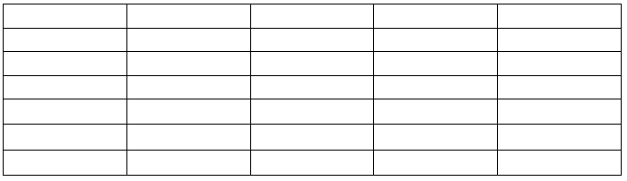
Output will be a dataframe that looks like:

Slide 13
Example 4: Do a left join where Illustration_Data_1 is the left and Illustration_Data_3 is the right.
example_4 <- Illustration_Data_1 %>%
left_join(Illustration_Data_3, by = c("Name" = "Name"))

Slide 14
Output will be a dataframe that looks like:

Slide 15
right_join() Function
Command Illustration
new_dataframe_name <- dataframe_left %>%
right_join(dataframe_right, c("colname_1" = "colname_2"))

Slide 17
Example 5: Do a right join where Illustration_Data_1 is the left and Illustration_Data_3 is the right.
example_5 <- Illustration_Data_1 %>%
right_join(Illustration_Data_3, by = c("Name" = "Name"))

Slide 18
Output will be a dataframe that looks like:

Slide 19
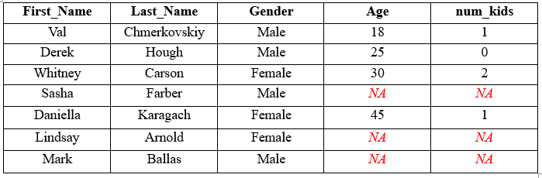
Summarizing NA's
Example 2 Output:

Slide 20

Example 6: Summarize the NA's for the left joined data from Example 2
example_6 <- example_2 %>%
summarize(num_people = n(),
num_na = sum(is.na(Age)),
num_not_na = sum(!is.na(Age)))

